Slide 1

Ansible Software

Slide 2



Why Ansible

Slide 3




What is Ansible
It is a tool that provides:
IT Automation
Configuration Management
Automatic Deployment

Slide 4
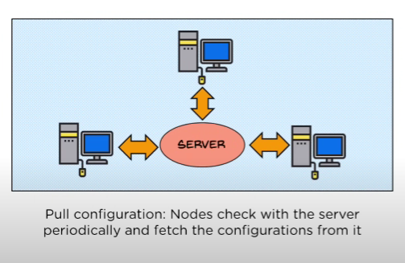
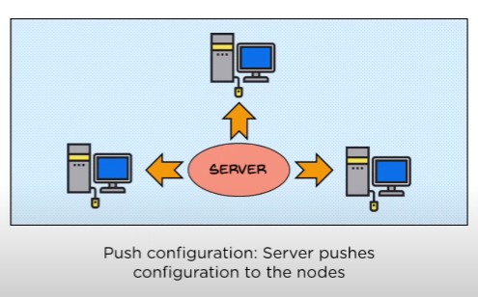
Key Features of Ansible
1) Free and Open Source
2) Agentless
There are 2 types of configurations
-> Pull Configuration
Used by softwares’ like Chef and Puppet
-> Push Configuration
Used by Ansible Software

Slide 5
Key Features of Ansible
3) Uses simple SSH or winRM connections
4) System requirements is very low
5) Entirely developed in python
6) Uses the YAML syntax in the configuration files (a.k.a Playbooks)
7) Quick Deployment

Slide 6






Architecture of
Inventory
Modules
(Playbooks)
Local Machine
Where ansible software is installed

Slide 7
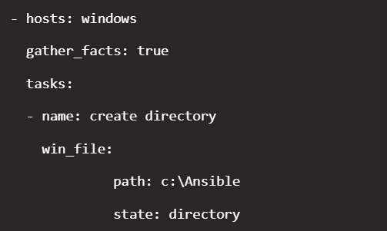
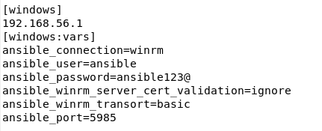
Inventory file and playbooks
Inventory file – This is the file in which we mention about which hosts or group of hosts we are targeting, their respective IP addresses, their usernames along with the passwords and the type of connection i.e if Linux hosts machines – SSH, if windows host machines – winRM.
Layout of a Inventory file
Playbook – These are files in which we write our code which we will execute on the host machines. These playbooks are written in yaml language which is very simple to understand and code.
Layout of a playbook file

Slide 8
Prerequisites:
Prerequisites:
1) The Local Machine from which we are planning to control other machines need to have Linux, Mac or BSD operating system
2) Must have Python installed (version 3.8 or later)
3) For linux host machines:
-> there are 2 ways we can communicate to the host machines
1) SSH key Authentication
2) SSH password Authentication
Should add the host machines fingerprint to the known-hosts file in the control node
This can be done using the command
ssh username@host
4) For Windows hosts machines:
-> Install pywinrm in the control node and communicate to the windows hosts via winRM (http - port 5985/https – port 5986)

Slide 9
System Requirements:
Here are the requirements on the control node for running ansible software.
Ram: | Minimum 1GB RAM
CPUs: | 4
Local Disk: | Minimum 40 GB with atleast 20 GB under var/lib/awx

Slide 10
Installation Process of Ansible:
Server Side Setup:
The installation involves very basic steps and can be setup in very short time.
1) To setup Ansible on a machine it has to must contain a linux, max or BSD operating system
Steps
apt install python3-pip
pip install pywinrm
apt install ansible
gedit /etc/ansible/hosts (This command is to edit the inventory files where the information of the hosts are present)

Slide 11
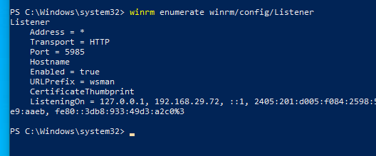
2) Client side setup:
For windows host machines
-> powershell version of 3.0 or newer must be installed on the host
-> winRM listening ports (5895 – http or 5896 – https)
For Linux host machines
-> if SSH key authentication is enabled then directly communication
-> if SSH password authentication is enabled then we need to include it in the known hosts file in the
Control node

Slide 12

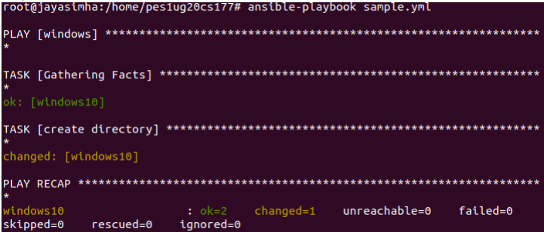
Ansible AWX
Ansible AWX is a web based user interface built on top of ansible with which we can have better control of our IT environments
Ansible from command line/terminal:

Slide 13
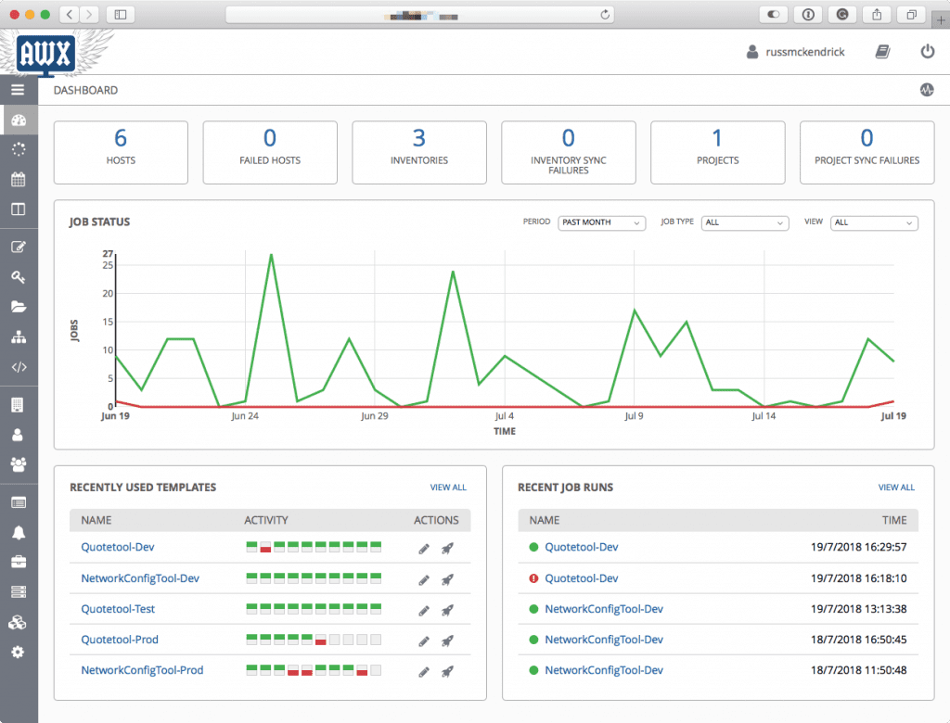

Slide 14

winrm
To communicate with Windows host systems, Ansible uses the Windows Remote Management (WinRM) protocol.
WinRM allows remote management and execution of commands on Windows systems.
To enable Ubuntu systems to communicate with Windows hosts through Ansible using WinRM, we need to install pywinrm in ubuntu through pip (package-management system written in Python).

Slide 15
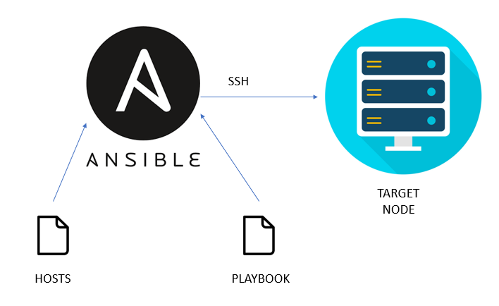
How ansible works
Inventory: Ansible starts by reading the inventory file, which defines the hosts and groups of hosts that Ansible will manage
Playbooks and Tasks: Ansible uses playbooks to define automation tasks and configurations.
WinRM Connection: Ansible establishes or WinRM connections with the target hosts specified in the playbook.
Task Execution: Ansible executes tasks defined in the playbook on the target hosts. Each task specifies a module to be used, which performs a specific action on the target hosts.

Slide 16
Inventory
An inventory is a file that defines the hosts and groups of hosts that Ansible can manage.
It serves as a central configuration file that organizes and categorizes the systems you want to control or automate.
On an Ubuntu host system, the inventory file can be located at /etc/ansible/hosts by default.
The inventory format by default and widely used is INI but other forms like YAML, JSON, etc. can be used

Slide 17
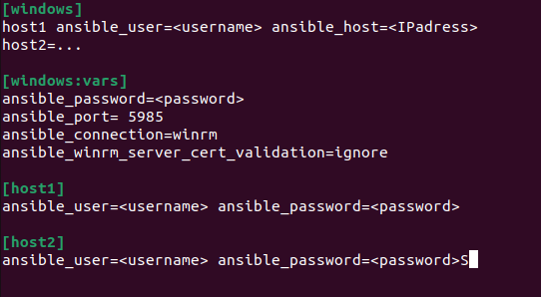
Inventory
Hosts: Each line in the inventory file represents a host that Ansible can manage.
Groups: You can group hosts together in the inventory file based on various criteria, such as their role, environment, or location.
Variables: You can assign variables to individual hosts or groups in the inventory file.

Slide 18
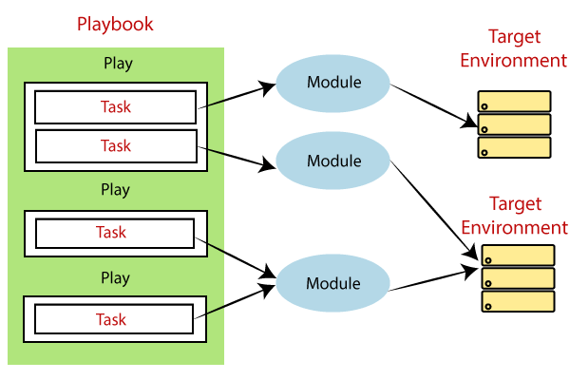
Modules
In Ansible, modules are standalone units of code that perform specific tasks or actions on the target hosts.
Modules can perform tasks such as executing commands, managing files, installing packages, making network connections, interacting with cloud providers, and more.
Modules can be used through playbooks or adhoc commands

Slide 19
Modules
Ansible modules are primarily created using the Python programming language.
There are modules available in other languages as well.
Ansible comes with a wide range of built-in modules that are included with the Ansible installation itself.
Apart from these built-in modules, we can create new modules or fetch from other sources as well
The Ansible documentation provides detailed guidelines and best practices for creating custom modules, including sample code and examples.

Slide 20
“Ad hoc” commands
In Ansible, ad hoc commands are one-time commands that you can run on remote hosts
Inventory Parsing: Ansible parses the inventory file to identify the target hosts.
Module Execution: Ansible uses the specified module to execute the ad hoc command on the target hosts. The selected module determines the action to be performed
Communication via WinRM: Since the target hosts are Windows machines, Ansible communicates with them using the WinRM
Module Execution on Target Hosts: The target hosts perform the necessary actions based on the command and return the results to the control node.
Result Reporting: Ansible collects the results of the ad hoc command execution from the target hosts and reports them back to the user.
Connection Termination: Once the ad hoc command execution is complete, the connection between Ansible and the target hosts is terminated.

Slide 21
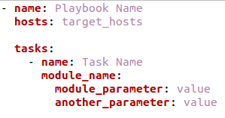
Playbooks and YAML
Ansible playbooks are files that define a set of automation tasks and configurations to be executed on target hosts.
Playbooks are written in YAML (Yet Another Markup Language) format, which provides a human-readable and easy-to-write syntax.
A playbook consists of one or more plays, where each play represents a set of tasks to be performed on a specific group of hosts.

Slide 22
Structure of a playbook
Playbook
├── Play 1
│ ├── Task 1
│ ├── Task 2
│ ├── ...
├── Play 2
│ ├── Task 1
│ ├── Task 2
│ ├── ...
└── ...

Slide 23
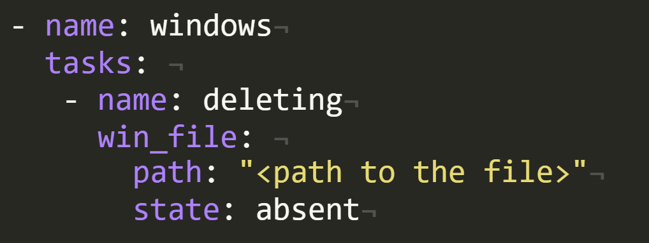
Playbook to delete file

Slide 24
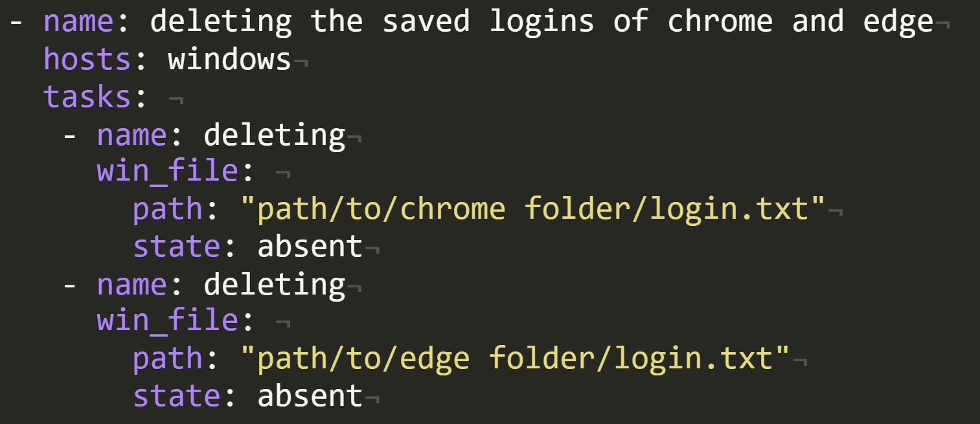
Playbook to delete saved logins of chrome and edge

Slide 25
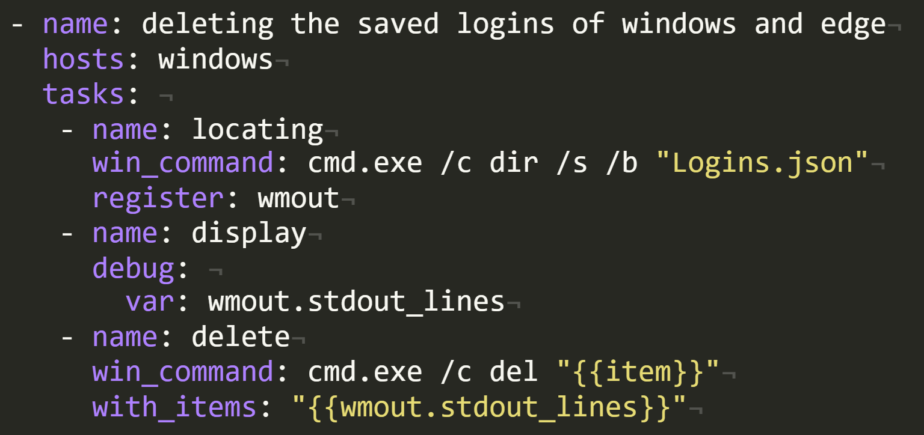
Playbook to delete the saved logins of firefox

Slide 26
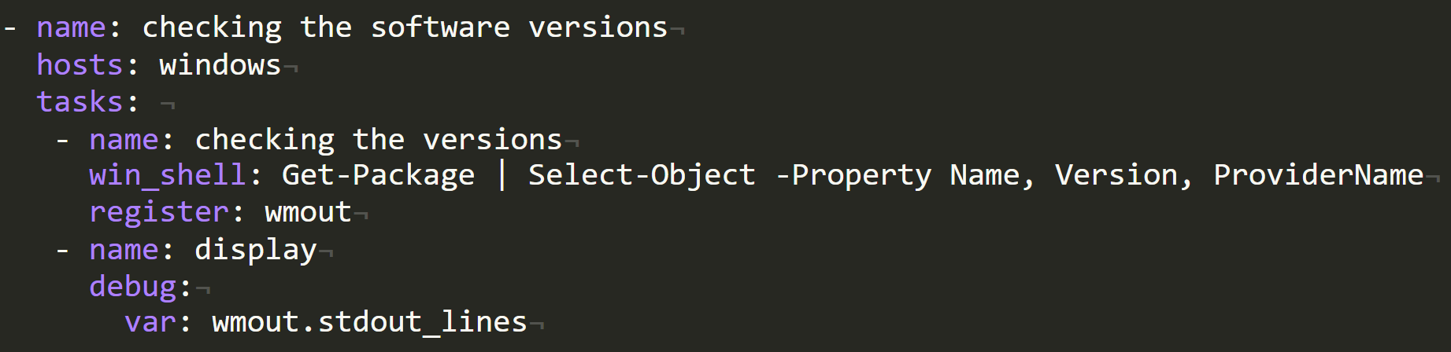
Playbook to check the versions of all softwares installed

Slide 27
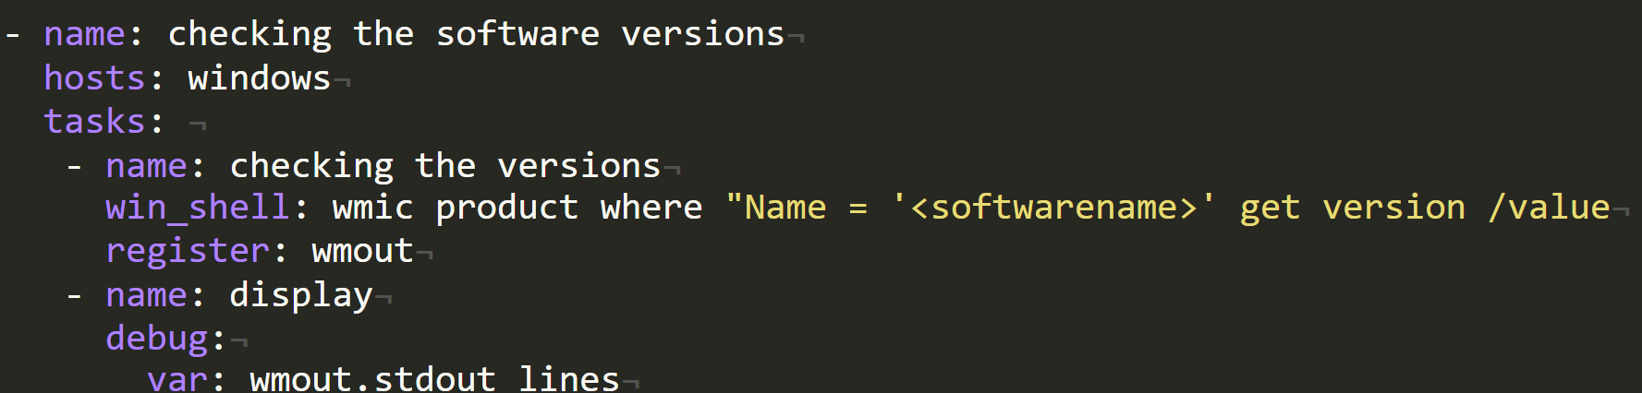
Playbook to check the version of a particular software

Slide 28
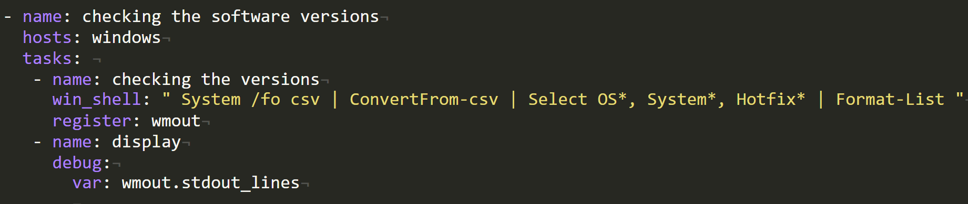
Checking the version of the host system operating system (windows)

Slide 29
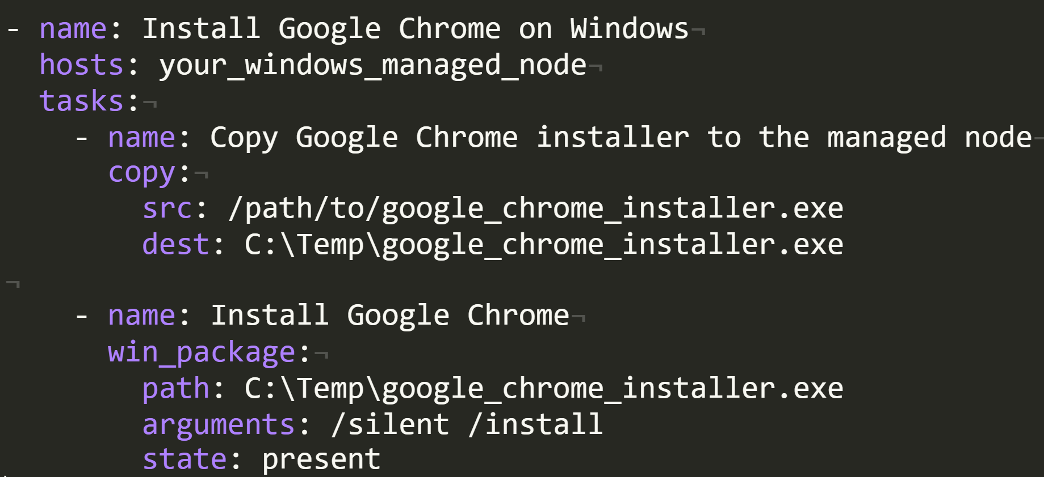
Playbook to install the softwares through ansible

Slide 30
references
https://www.ansible.com
https://docs.ansible.com/ansible/2.9/modules/list_of_all_modules.html
https://www.tutorialspoint.com/yaml/index.htm
https://docs.ansible.com/ansible/latest/installation_guide/intro_installation.html

Slide 31


